Slide 1
V-Invent Team
Date: 20th May 2022
Digital Asset Management System - CatalystAI
Image, Document optimization, Identification and Optical Character Recognition
Using ML/AI and Cloud Technologies
By: Ishwar Patil and Akhilesh Dixit

Slide 2
Digital Asset Management System A Gateway to the New World of Digital Banking - CatalystAI
PROPOSITION
Digital assets have long evolved since last one decade in Banking industry.
Today
Small Investment in “Digital Banking”
Tomorrow
Material Reduction in Product Time-To-Market
Banking clients are increasingly demanding Digital Asset Management System that enables access to new digital markets.
Our current lack of digital asset management capabilities can expose Banking industry to:
Revenue reduction, loss of client wallet share to competition, drop in AuM (Asset Under Management).
Inability to complete for the future generation of “Digital Native” Customers.
Our Proposal:
Efficient Processing, Storage and Retrieval of Documents.
As India aims to bring more and more people online and associate them with the banking infrastructure, there is a need to process the information accurately and quickly.
With the use of Machine Learning in the Cloud, many of the banking processes like Account Opening, KYC Verification, Applications etc. can be automated to a certain extent thus reducing the time required for the same.
Product can be use for document Risk Analysis and also can be extended for Digital Asset like Crypto Currency Risk Analysis in Future using AI Techniques.

Slide 3
Digital Asset Management System
Taking Banking Industry from Zero capability towards “An Innovative Business Offering”.
Rising Adoption of Digital Banking Platform Among SMEs is Driving Market Growth.
WHAT ARE THE MAJOR PAIN POINTS?
HOW BIG IS THE PROBLEM?
IMPACT IF UNCHANGED?
Client demand for Digital assets vs Major Bank’s total lack of offering.
Expected accelerated of asset outflows to digital-friendly platforms.
International competitors already have a significant early advantage.
Existing Manual Data Entry causing Repetitive task utilizing human hours and Human Errors.
Difficulty in Retrieval of Documents.
Scalability of Digital Assets Platform.
A recent study, conducted by the strategic consulting and market research firm BlueWeave Consulting, revealed that India digital banking platform market was worth USD 776.7 million in the year 2021. According to the study, the market is estimated to grow at a CAGR (Compound Annual Growth Rate) of 9.8%, earning revenue of around
USD 1,485.5 million by the end of 2028.
The growth of the India digital banking platform market can be attributed to rapid digitization and growing adoption of advanced technologies, such as cloud computing, Artificial Intelligence etc.
Loss of high margin revenue opportunities.
Risk of losing existing clients.
Compounding effects of AuM off-boarding.
Inability to engage with the future generation of customers.
Continuously increasing gap between Indian Banks vs International Peers & Neo Banks.
Perception of Indian Bank as an entrepreneurial brand can suffer.

Slide 4
Digital Asset Management System MVP Platform for Digital Assets Optimization and OCR Processing. Organization which requires to process Application Forms, KYC Documents, Invoices, Claim Forms etc. can greatly benefit using product.
PROPOSED SOLUTION
WHAT?
HOW?
Document / Image Pre-Processing.
Segmentation and Feature Extraction.
Optical Character Recognition (OCR) along with Data extraction, Data analysis and Data Preparation.
Model Training, Evaluation, Validation, Serving and Monitoring.
Tag and AI based categorization.
Final OCR-Output.
Optical Character Recognition NLP algorithms can be based on traditional image processing and machine learning-based approaches or deep learning-based methods or any native cloud microservice e.g. Azure Cloud Computer vision services.
Document Identification.
Data Entry Automation.
Pattern Recognition.
Feature Detection or Intelligent Character Recognition (ICR).
Text Translation, Recognition and Evaluation.

Slide 5
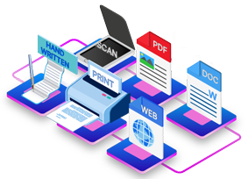
Digital Asset Management System – OCR based CatalystAI MVP Offering – Proposed Components Solution - CatalystAI.
Optical Character Recognition
Enterprise Integration via Cloud Services
CatalystAI
Product
NLP and
Object Detection
Information Search

Slide 6
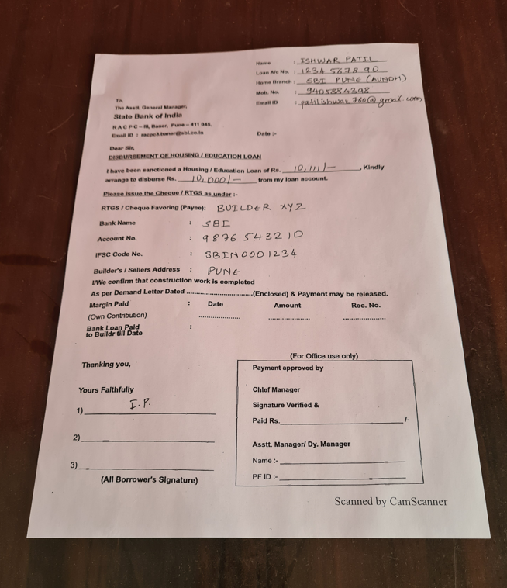
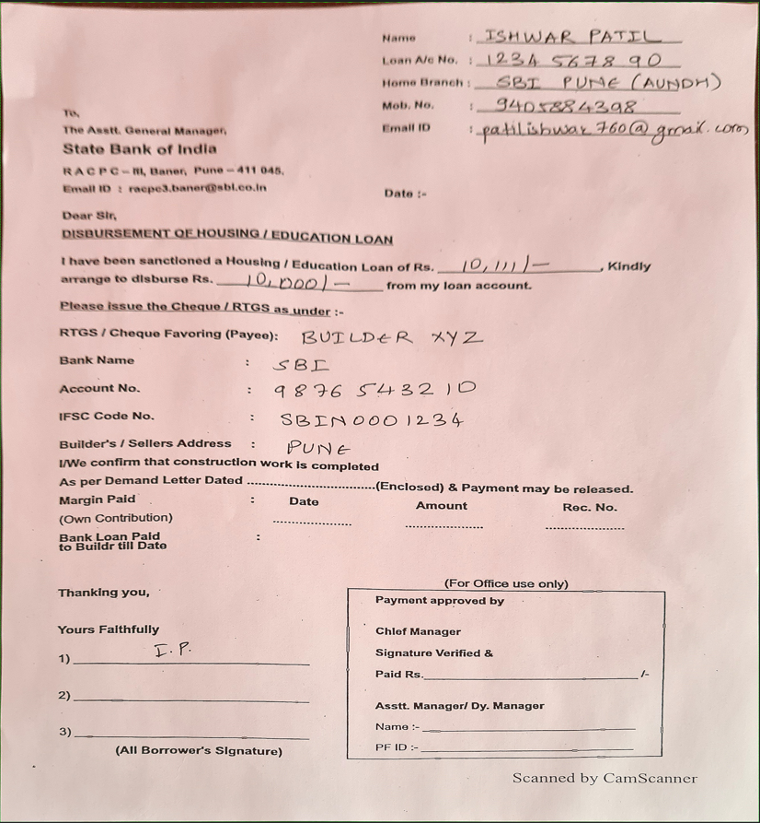
Catalyst AI Document Pre-Processing Steps
Document / Image Pre-Processing.
Segmentation and Feature Extraction.
Optical Character Recognition (OCR) along with Data extraction, Data analysis and Data Preparation.
Model Training, Evaluation, Validation, Serving and Monitoring.
Tag and AI based categorization.
Final OCR-Output.
Reduce Whitespace, reduce size,
Refocus the picture,
centrally align the page
To Azure Vision
Service
Original Image
Processed Image
(Ready for OCR)

Slide 7
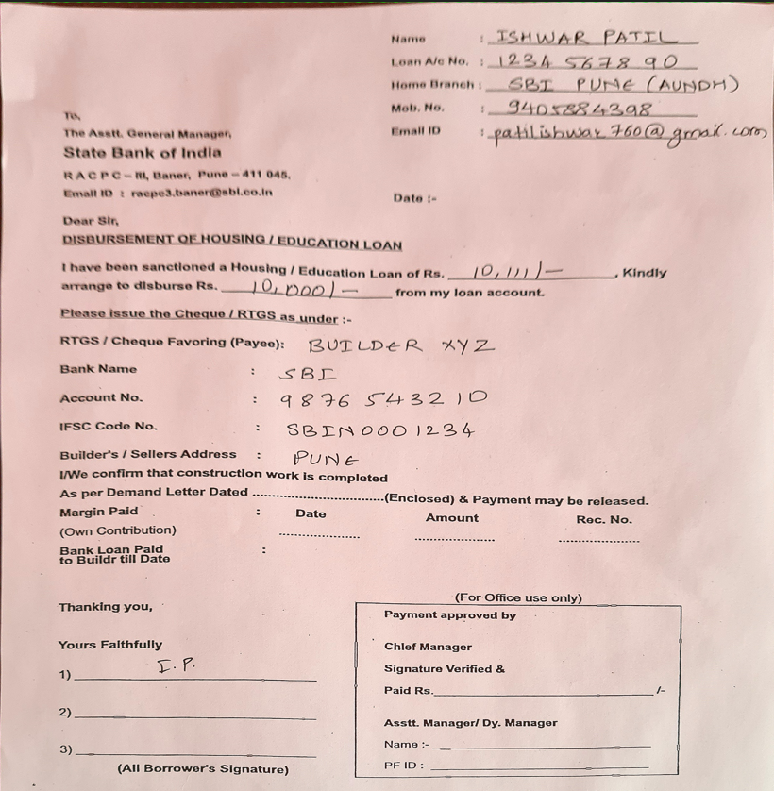
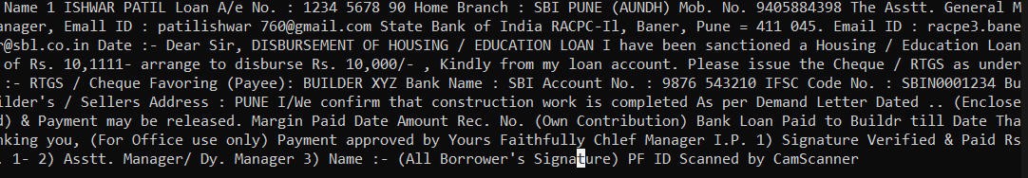
Catalyst AI Document Processing and Section Extraction
The Computer vision service helps in reading the text from the document using OCR.
The output from OCR is sent to LUIS (Language Understanding Service from Microsoft) and the document is sent to a AI based document parser.
The document is sent to a similarity based ML model which helps in identifying the attached documents with the form. For ex. Aadhar card, Pan Card, Driving License etc.
All the personal document numbers are also highlighted which are then masked.
Combined output from the document parser and LUIS Vision APIs helps in categorizing the complete documents in sections.
LUIS
OCR
Text
AI Document Parser

Slide 8
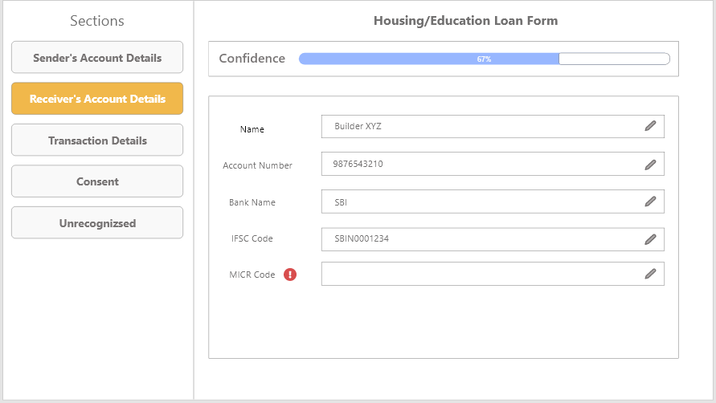
Tag and AI based categorization
LUIS
Identified
Entities
AI Document Parser

Slide 9
Flow
Import Files
(Photo, PDF etc.)
Pre-Process the files and make them OCR-Ready
Using Azure Computer Vision, extract text and upload the document to Blob Storage
Validate the values that are extracted. Based on the confidence score, make any changes if required and submit.
Send the categorized document to the UI for final review
Using LUIS and AI Based Document parser, identify the type of document and then categorize the contents
Save the tags and entities to the DB which will help the retrieval of the document when required

Slide 10
Catalyst AI - Key Differentiators & Adoption Plan
With help of Microsoft’s LUIS and AI based Document Parser, the categorization of data is accurate which helps in reducing Human Effort.
Being a SaaS offering, scalability is not an issue.
The more the ML Model is used, the more accurate it gets as it keeps improving the extraction score.
As API platform would also be available, adoption would be a plug and play. The API needs to be introduced in between the end user who will be uploading the forms and the employee who will be responsible for processing those forms.

Slide 11
Catalyst AI – How far this product can go?
This product can be use for Cognitive Document Processing using AI for secured, multilingual processing from unstructured, semi-structured docs for faster go no-go decision making.
Document processing cannot be done alone by use of Optical Character Recognition (OCR) and Intelligent Character Recognition (ICR).
CatalystAI platform uses Machine Learning / Deep Learning (ML/DL), Neural Networks, Natural Language Processing (NLP) technologies and their combinations for handling (a) auto classification of documents (b) auto extraction of meaningful information (c) hundreds and thousands of variations in the formats (d) handwritten documents (e) multi-lingual documents and at the same time provide higher accuracy.
Data verification or data analysis is also done to help quick business decision making.
CatalystAI Platform has potential to discover document information for business insights with increased accuracy (80-97%), productivity (60+ %) and user experience (30+ % error reduction).

Slide 12
Azure Services Used:
Computer Vision – For OCR, Document Identification
Azure ML.NET – For ML Model hosting
Microsoft LUIS – For Entity-based text classification
Azure VM Services – For hosting the complete solution
Azure DevOps – For CI/CD

Slide 13


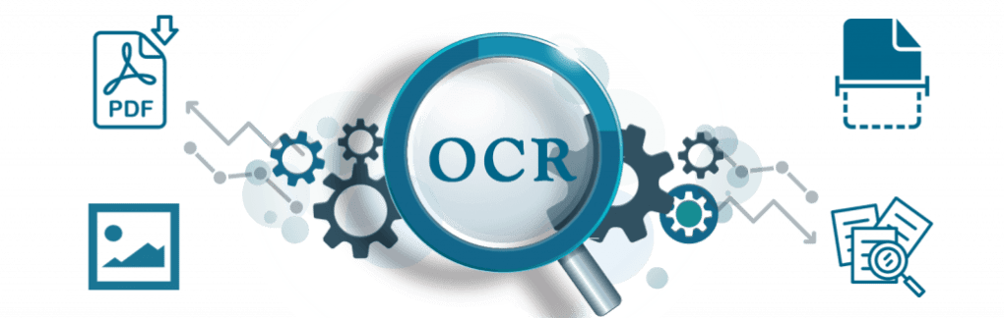
Catalyst AI - GitHub Repository Link
GitHub:
https://github.com/akhilvinvent/vinvent-web
https://github.com/akhilvinvent/vinvent-api

Slide 14
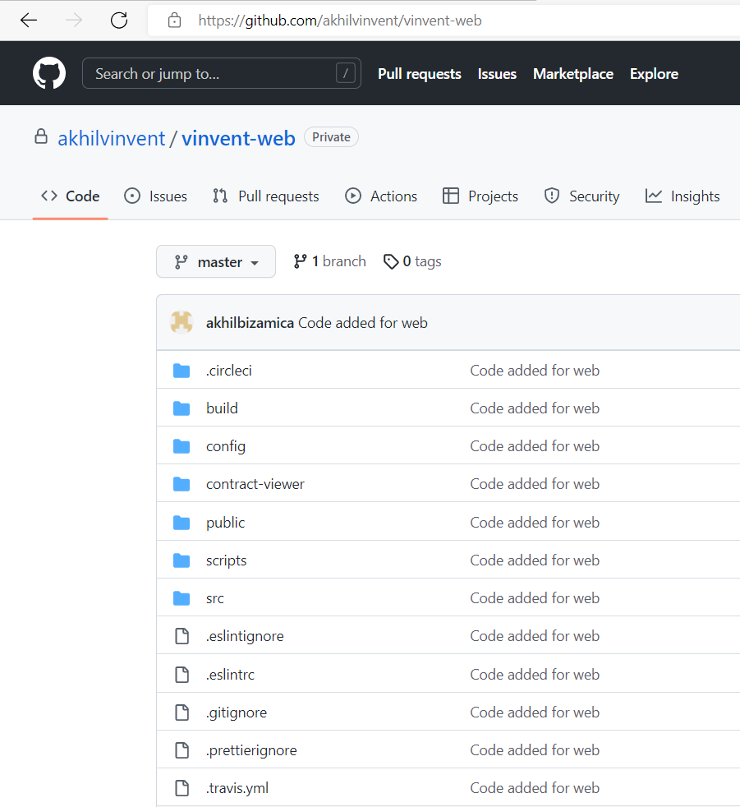
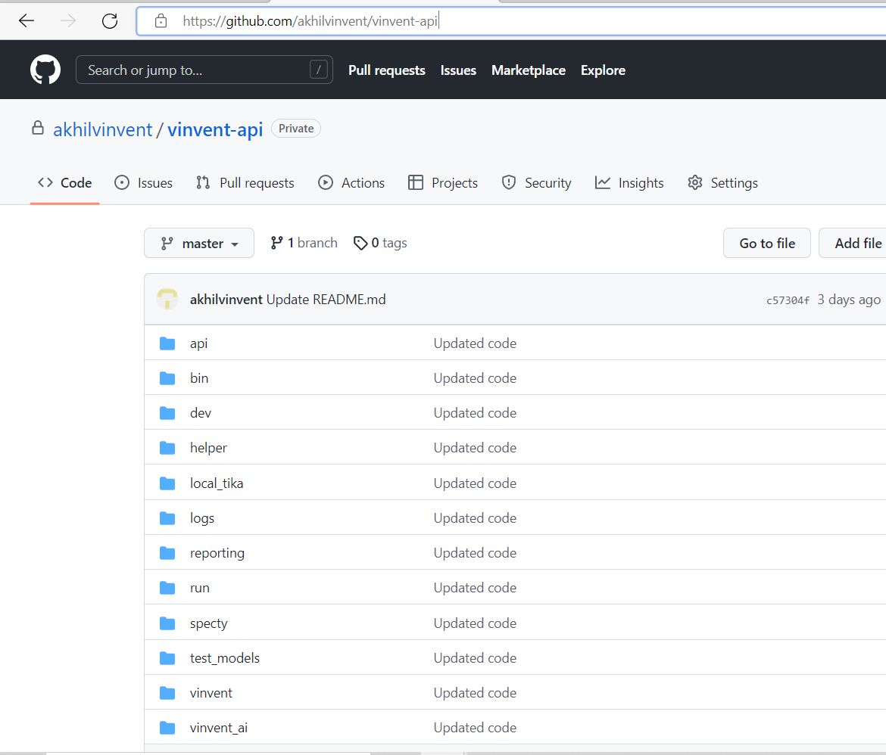
Catalyst AI - GitHub Repository

Slide 15
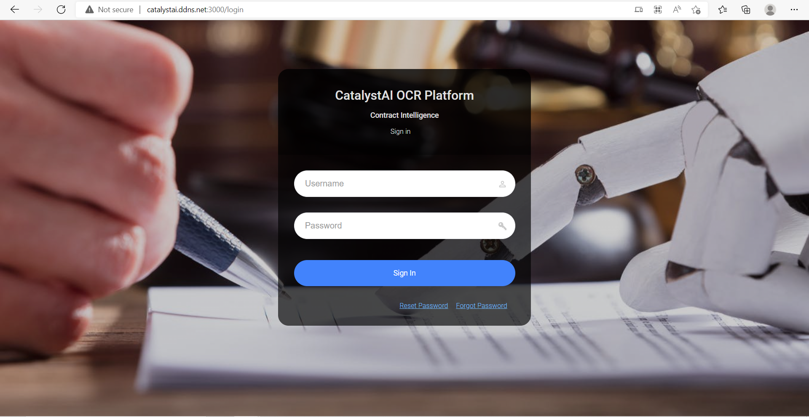
Catalyst AI - Demo Video/ Screenshot
VInvent Tech Team CatalystAI http://catalystai.ddns.net:3000/login
Demo Video: https://drive.google.com/file/d/14r4apxyMUw5HQX5YNNNtmQQuk2PeYUOx/view?usp=sharing

Slide 16
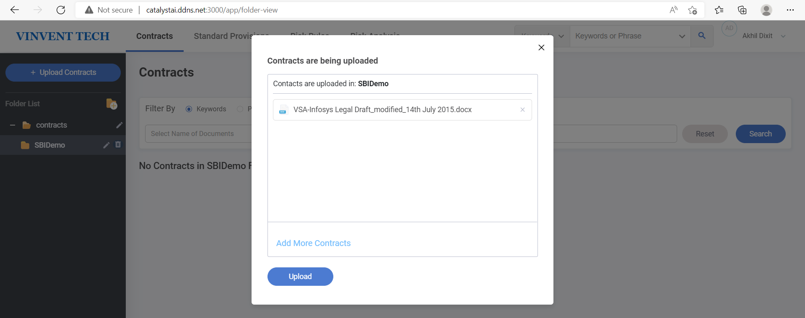
Catalyst AI - Demo Video/ Screenshot
Document upload and Apply OCR Parsing for Docs.

Slide 17
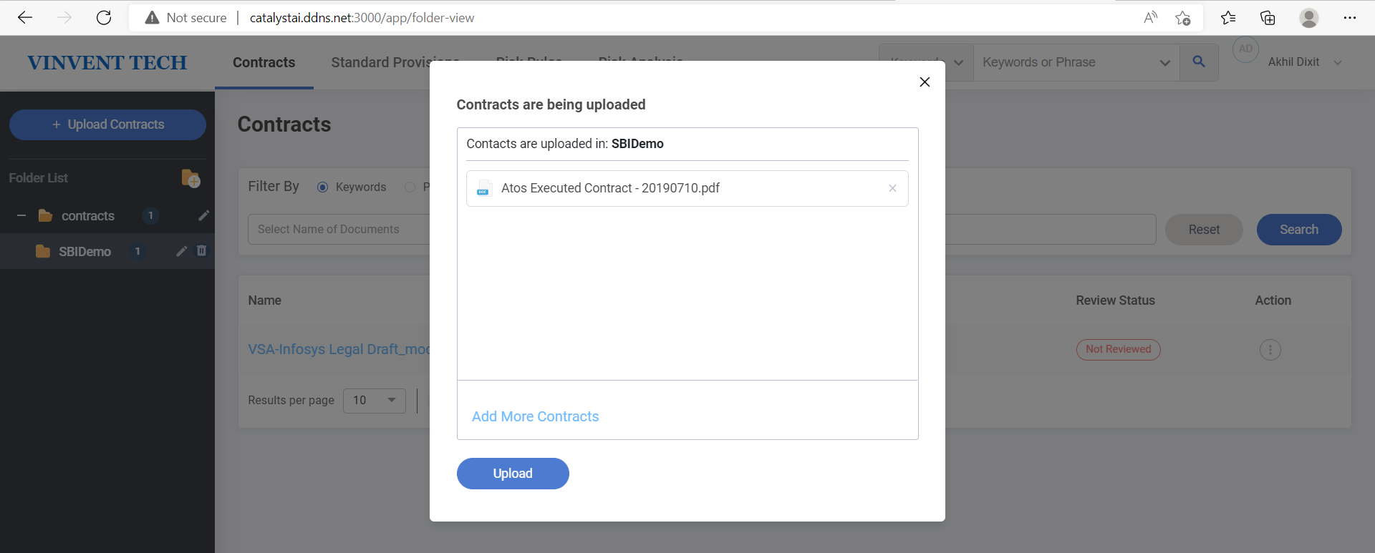
Catalyst AI - Demo Video/ Screenshot
Document upload and Apply OCR Parsing for PDF document.

Slide 18
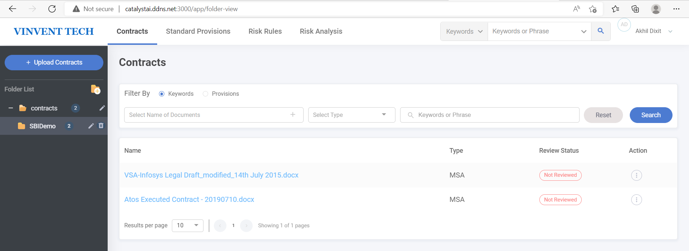
Catalyst AI - Demo Video/ Screenshot
OCR Parser has parsed PDF document and converted it to docx format.
Document is ready for Test analysis, NLP and Review.
Document tags information is also stored in Database and Elastic Search Index.

Slide 19
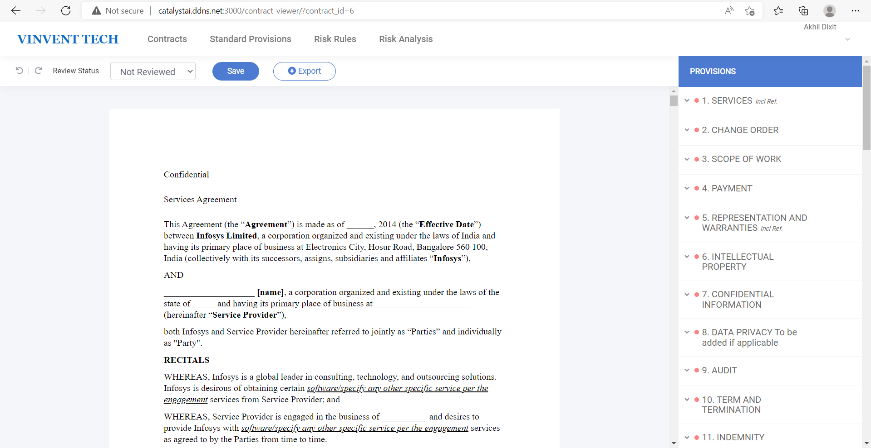
Catalyst AI - Demo Video/ Screenshot
Docx document converted into docs and ready for Legal Analysis or Review after OCR parsing.

Slide 20
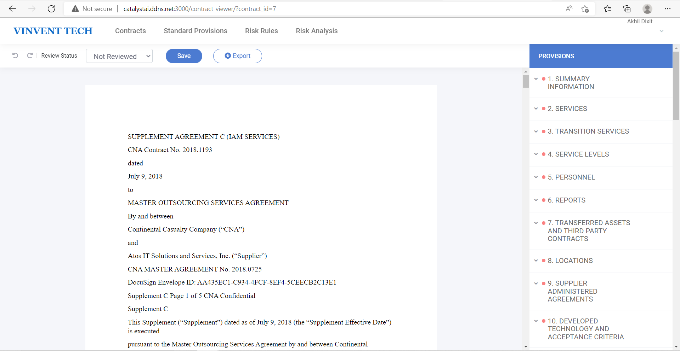
Catalyst AI - Demo Video/ Screenshot
PDF document converted into docs and ready for Legal Analysis or Review after OCR parsing.

Slide 21
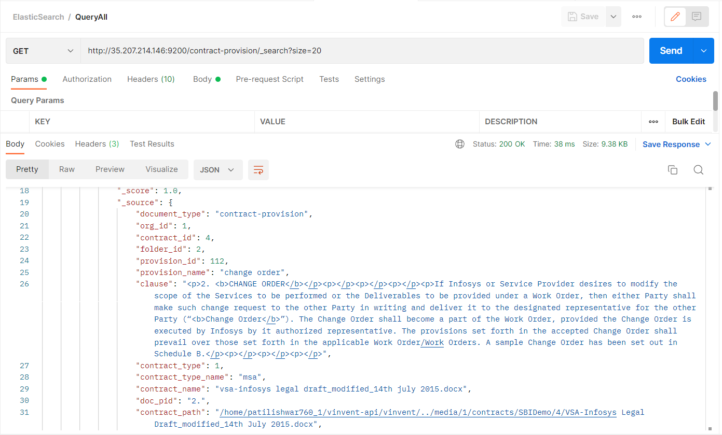
Catalyst AI - Demo Video/ Screenshot
PDF document converted into docs and ready for Legal Analysis or Review after OCR parsing.

Slide 22
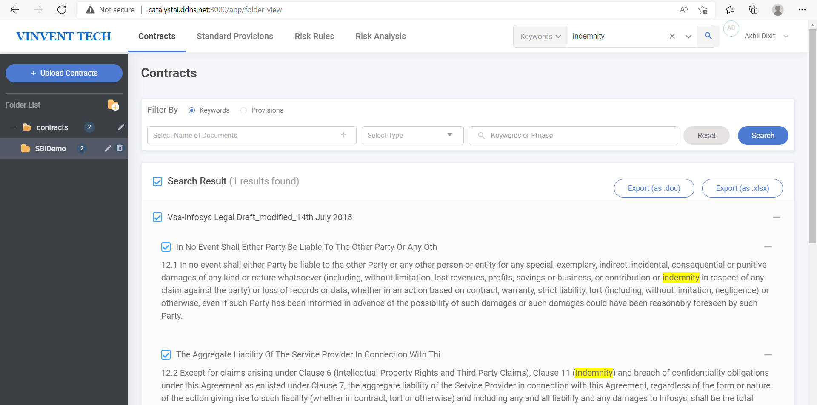
Catalyst AI - Demo Video/ Screenshot
CatalystAI Product can be use for Text based, Synonyms, Acronyms etc Search into document on NLP and ElasticSearch.

Slide 23
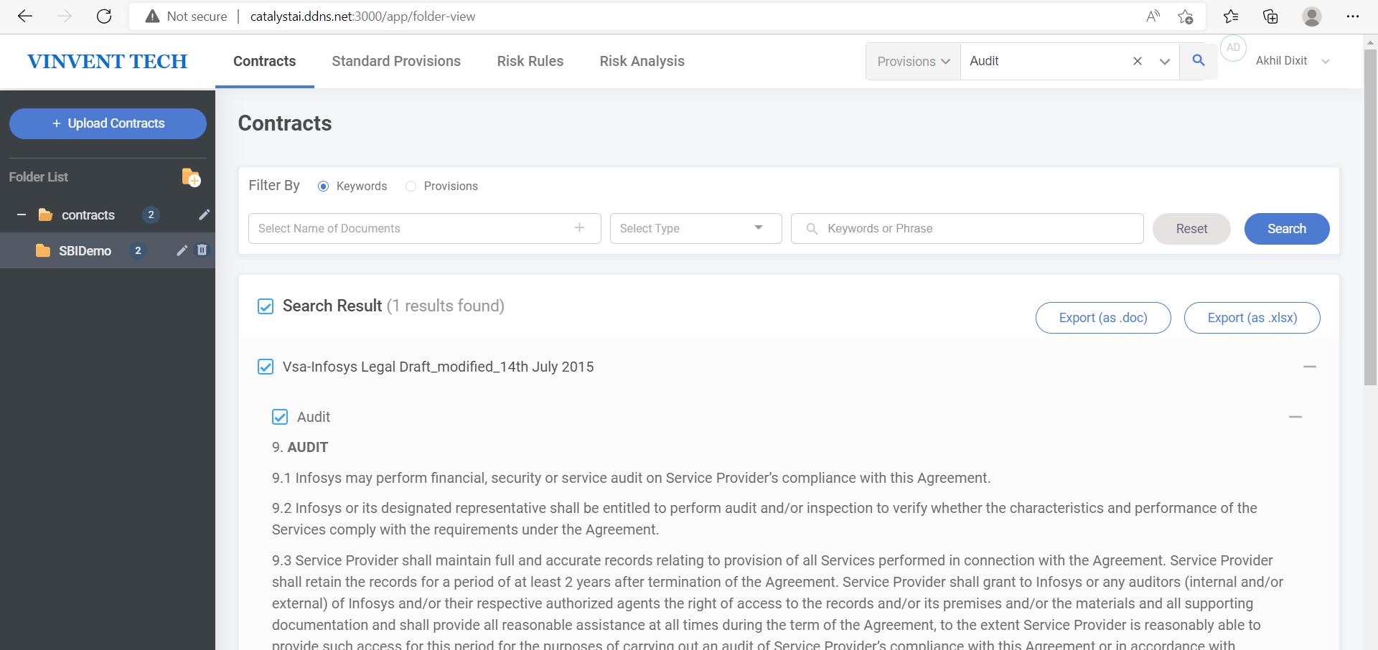
Catalyst AI - Demo Video/ Screenshot
CatalystAI Product can be use for Text based, Synonyms, Acronyms etc Search into document on NLP and ElasticSearch.

Slide 24
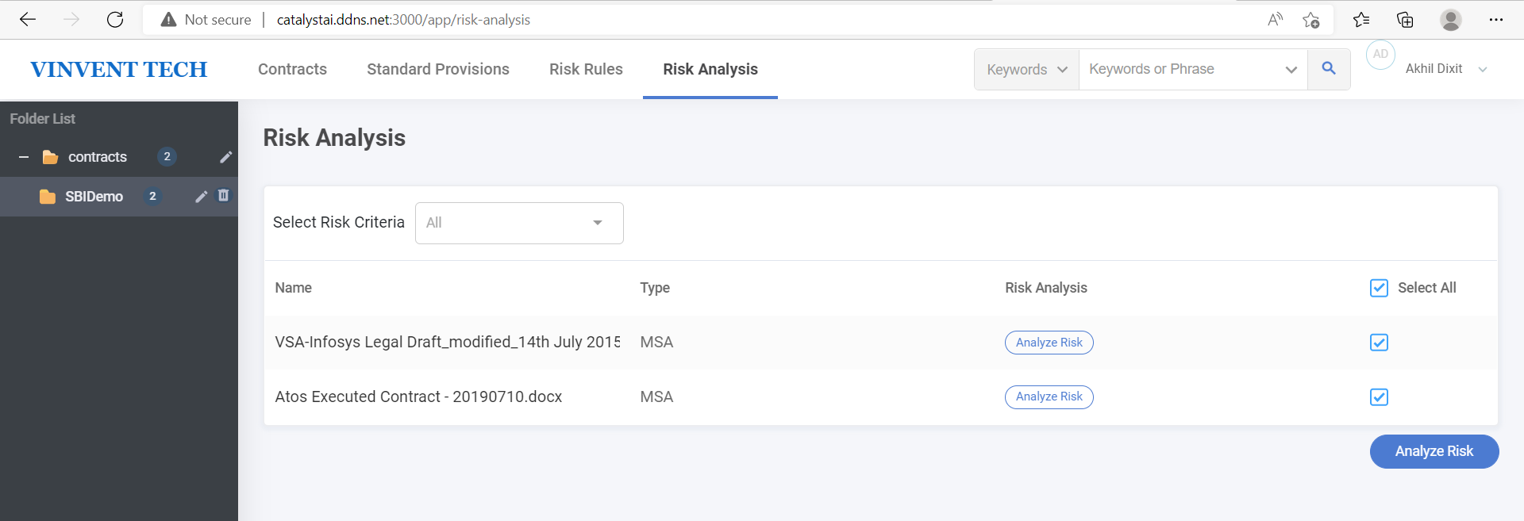
Catalyst AI - Demo Video/ Screenshot
CatalystAI Product can be use for Risk Analysis based on ML/DL Model Similarity Index.

Slide 25
Thank You
Akhilesh Dixit
Ishwar Patil

